Slide 1







your Company
Presentation
Simple templates for any length
yourcompany.com

Slide 2








YOUR NAME / PRESENTATION
YOUR COMPANY
AGENDA
Market Challenge
01
Addressing the urgent need for scalable catalyst production.
Our roadmap from technical validation to commercial scalability.
Our Solution
02
Proprietary technology ensuring high reproducibility and yield.
03
Performance Proof
Data validating superior efficiency and operational stability.
04
Differentiation
Unique IP securing our cost and quality advantages.
05
Business Roadmap
Execution plan for pilot scaling and partnerships.

Slide 3






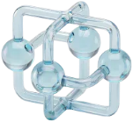
YOUR NAME / PRESENTATION
YOUR COMPANY
CRITICAL BOTTLENECKS
PERFORMANCE LIMITS
Conventional catalysts have plateaued. Incremental improvements are no longer sufficient to meet the energy demands of modern industrial processes.
SCALABILITY GAP
Current methods struggle to scale effectively, limiting the ability to meet large scale industrial production needs efficiently.
Current catalyst production is costly, unpredictable, and dirty.
Current manufacturing relies on imprecise methods. This results in wasted resources, high emissions, and an inability to meet strict new environmental standards.
60%
COST INEFFICIENCY
Without atomic precision, most expensive precious metals are inactive, driving up costs and significantly reducing profit margins.
METAL WASTED

Slide 4
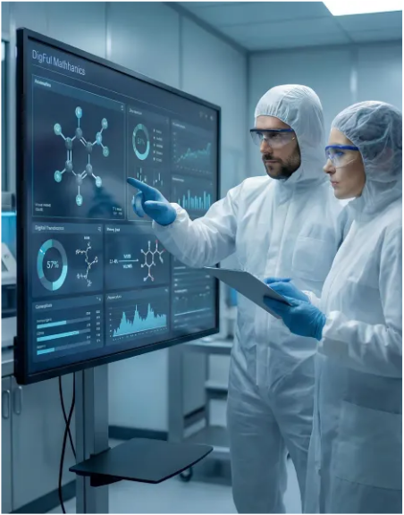

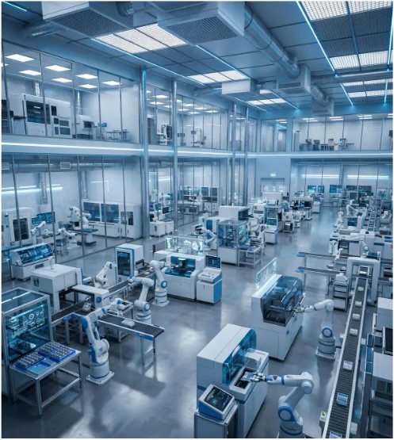
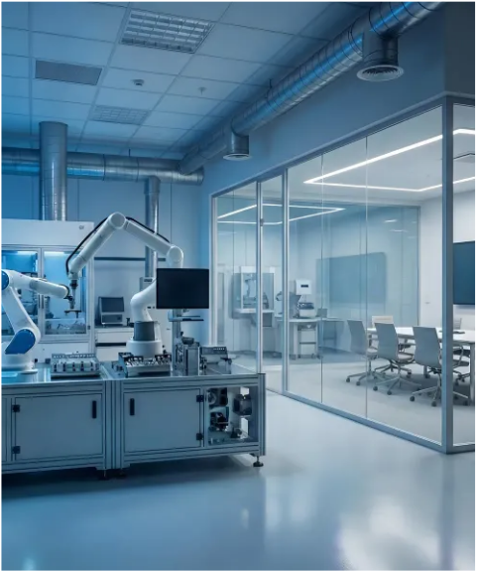

YOUR COMPANY
OUR SOLUTION
Bridging the critical gap between lab discovery and mass production.
We standardize catalyst synthesis using automated robotic systems.
This results in wasted resources, high emissions, and an inability to meet strict new environmental standards.
This eliminates reproducibility risks common in traditional chemical research and manufacturing.
This accelerates development cycles from years down to just a few months.

Slide 5



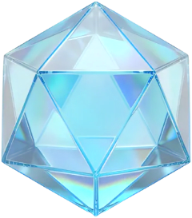









YOUR NAME / PRESENTATION
YOUR COMPANY
SOLUTION
SUITE
Delivering scalable industrial catalysts through automated synthesis and AI-driven design.
CORE PLATFORM
APP PACKAGES
Our automated foundry standardizes nanomaterial production for scale, while our pre-validated libraries enable rapid industrial integration.
Our automated foundry standardizes nanomaterial production for scale, while our pre-validated libraries enable rapid industrial integration.

Slide 6

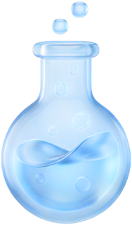
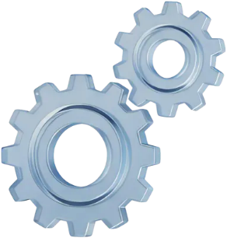
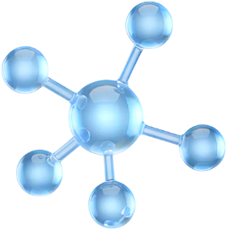

YOUR NAME / PRESENTATION
YOUR COMPANY
HOW IT WORKS
Our process transforms theoretical designs into industrial realities through a rigorous four-stage engineering workflow.
Rational Design
Controlled Synthesis
Surface Anchoring
Mass Production
The specific engineering step ensures reproduction and scale.
The specific engineering step ensures reproduction and scale.
The specific engineering step ensures reproduction and scale.
The specific engineering step ensures reproduction and scale.

Slide 7



YOUR NAME / PRESENTATION
YOUR COMPANY
UNRIVALED PEFRORMANCE METRICS
KEY METRIC
99.9%
Product Selectivity
KEY METRIC
3x
High Reaction Rate
Our technology demonstrates superior catalytic efficiency and stability compared to industry standards.
KEY METRIC
5
40%
Core Patents Secured
Reduction in Energy Costs
STABILITY TEST
15,000
By enabling low-temperature activation, our catalyst significantly lowers thermal energy requirements, directly translating to higher operating margins.
Continuous
Operation

Slide 8
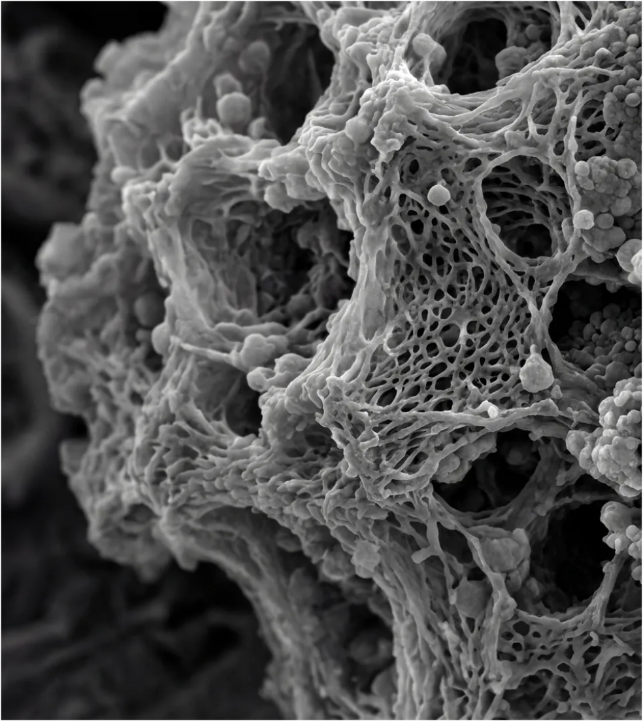










YOUR NAME / PRESENTATION
YOUR COMPANY
5,000h
98%
Stability
CONTINUOUS RUN/ <1% LOSS
Selectivity
VS. MARKET AVERAGE
40%
BENCHMARK RESULTS
Cost Cut
3x
CONTINUOUS RUN/ <1% LOSS
6
Yield Increase
Demonstrating superior stability, efficiency, and scalability against commercial standards.
GRAM-PER-GRAM OUTPUT
TRL Status
PILOT-READY VALIDATED

Slide 9












YOUR NAME / PRESENTATION
YOUR COMPANY
KEY DIFFERENTIATORS
Our proprietary synthesis platform solves the trilemma of activity, durability, and scalability that limits conventional nanocatalysts.
OUR TECHNOLOGY
CONVENTIONAL METHODS
1
Scalable continuous synthesis.
1
Limited batch processing.
2
Atom-level precision control.
2
Inconsistent quality control.
3
Validated cost efficiency.
3
High raw material waste.
Our continuous flow reactor design ensures that the high performance achieved in the lab is perfectly replicated at industrial scale without degradation.
Standard batch manufacturing methods suffer from significant variability and yield losses during scale-up, making high-performance catalysts unviable.

Slide 10




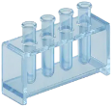









YOUR NAME / PRESENTATION
YOUR COMPANY
COMPETITIVE LANDSCAPE
HIGH PERFORMANCE
Our platform breaks the traditional trade-off between catalytic performance and industrial scalability, offering a clear path to mass adoption.
Our System
Academic Labs
LAB SCALE/HIGH COST
MASS PRODUCTION READY
Noble Metals
Bulk Catalysts
3 Joint Development Agreements
LOW PERFORMANCE
While competitors struggle with rare metal volatility or synthesis complexity, we deliver consistent, high-yield catalysts ready for existing production lines.
MARKET POSITIONING

Slide 11
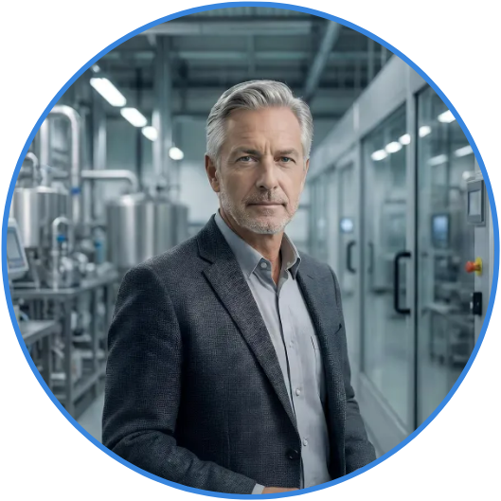


YOUR NAME / PRESENTATION
YOUR COMPANY
TARGET AUDIENCE
Identifies the ideal industrial partners and decision-makers for adoption.
PARTNER ANALYSIS
Ideal Partner
Large-scale chemical manufacturers seeking efficiency.
Partner Profile
Key Needs
Reducing noble metal production costs.
Meeting strict global ESG targets.
Ensuring scalability in mass production.
Sector | Petrochemical & Energy
Market | Global Industrial Hubs
Role | CTO / R&D Head
Scale | High Volume CapEx.
Use Context
Retrofitting existing catalytic reactor lines.

Slide 12




YOUR NAME / PRESENTATION
YOUR COMPANY
SCALING ROADMAP
Our 18-month roadmap bridges the gap between lab research and mass production.
This schedule outlines critical milestones to de-risk technology and prove scalability to partners.
 | FOCUS | ACTION | RESULT
Phase 01 | Pilot validation step | Pilot validation step | Pilot validation step
Phase 02 | Pilot validation step | Pilot validation step | Pilot validation step
Phase 03 | Pilot validation step | Pilot validation step | Pilot validation step
Phase 04 | Pilot validation step | Pilot validation step | Pilot validation step
MILESTONE STRATEGY
Execution focuses on meeting industrial partner standards for immediate adoption.

Slide 13









YOUR NAME / PRESENTATION
YOUR COMPANY
EXTERNAL
COLLAB
JOINT R&D POC
Collaborate to optimize catalyst performance specifications for your unique feedstocks and reaction environments.
TECH LICENSING
Transfer proprietary synthesis protocols and IP rights for your internal manufacturing capabilities.
We offer flexible engagement models designed to align with your strategic roadmap.
DIRECT SUPPLY
Receive stable, high-purity catalyst shipments directly from our pilot foundry for mass production.
From initial Proof of Concept to full commercial rollout, we structure partnerships that minimize risk and accelerate industrial integration.

Slide 14

















YOUR NAME / PRESENTATION
YOUR COMPANY
ENGAGEMENT MODELS
Structured commercial tiers scaling from initial validation to mass production.
$5k+
$10k+
$15k+
$20k+
VALIDATION KIT
VALIDATION KIT
VALIDATION KIT
VALIDATION KIT
Standard sample package for initial lab-scale performance screening and feasibility testing.
Standard sample package for initial lab-scale performance screening and feasibility testing.
Standard sample package for initial lab-scale performance screening and feasibility testing.
Standard sample package for initial lab-scale performance screening and feasibility testing.
REQUEST SAMPLE
REQUEST SAMPLE
REQUEST SAMPLE
REQUEST SAMPLE

Slide 15






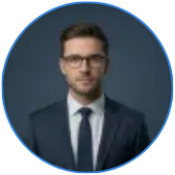






YOUR NAME / PRESENTATION
YOUR COMPANY
LEADERSHIP TEAM
ROLE/EXPERTISE
ROLE/EXPERTISE
ROLE/EXPERTISE
Dr. Expert Member
Dr. Expert Member
Dr. Expert Member
Proven track record in catalyst synthesis & pilot plant operations
Proven track record in catalyst synthesis & pilot plant operations
Proven track record in catalyst synthesis & pilot plant operations
Bridging the gap between deep science and industrial scale.
We are more than researchers. Our multidisciplinary team unites PhD-level material scientists with veteran process engineers to ensure every innovation is reproducible, scalable, and commercially viable.
ROLE/EXPERTISE
ROLE/EXPERTISE
ROLE/EXPERTISE
Dr. Expert Member
Dr. Expert Member
Dr. Expert Member
Proven track record in catalyst synthesis & pilot plant operations
Proven track record in catalyst synthesis & pilot plant operations
Proven track record in catalyst synthesis & pilot plant operations

Slide 16



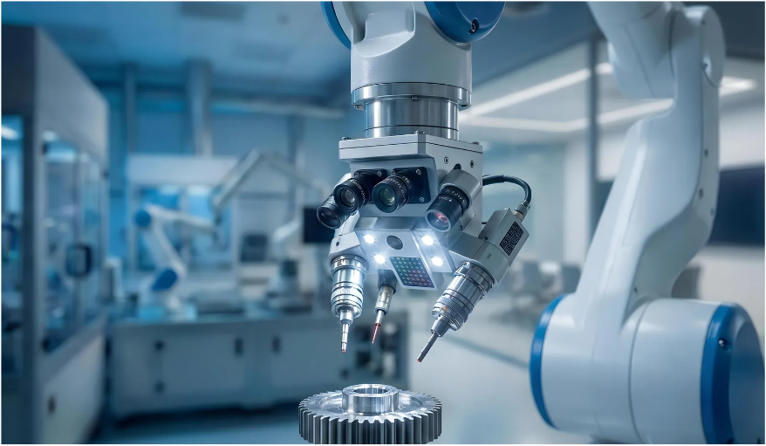







YOUR NAME / PRESENTATION
YOUR COMPANY
CONTACT
We are prepared to validate our reproducibility and scalability. Request access to our full technical Data Room or schedule a Pilot Scoping Workshop today.
Phone
Website
123.456.7890
yoursitehere.com
Our leadership team is available to discuss investment terms, joint development timelines, and commercial licensing models immediately.
Email
Location
yourname@email.com
123 Anywhere City

